Slide 1
CSE 12 – Basic Data Structures and Object-Oriented Design Lecture 17
Greg Miranda and Paul Cao, Winter 2021
This lecture is being recorded

Slide 2
Announcements
Quiz 17 due Friday @ 8am
Survey 7 due Friday @ 11:59pm
PA6 due Wednesday @ 11:59pm

Slide 3
Topics
Questions on Lecture 17?
Linear Probing

Slide 4
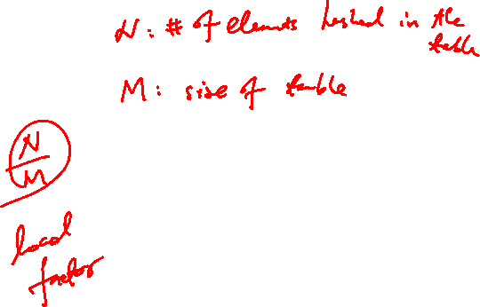
Hash Table – draw the picture (Separate Chaining)
int getIndex(String k) {
return k.length;
}
# of buckets – 6
(i.e. the size of the array)
set(“Smith”, 1);
set(“Maria”, 2);
set(“Christine”, 3);
set(“Brown”, 4);
set(“Julia”, 5);
set(“Garcia”, 6);
set(“Miller”, 7);
set(“Davis”, 8);
set(“Wesley”, 9);
set(“Martinez”, 10);

Slide 5
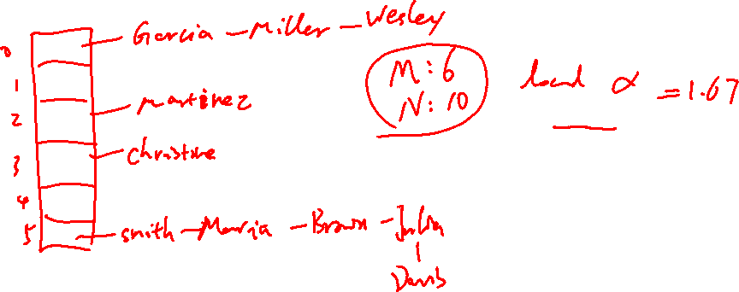
int getIndex(String k) {
return k.length;
}
set(“Smith”, 1);
set(“Maria”, 2);
set(“Christine”, 3);
set(“Brown”, 4);
set(“Julia”, 5);
set(“Garcia”, 6);
set(“Miller”, 7);
set(“Davis”, 8);
set(“Wesley”, 9);
set(“Martinez”, 10);

Slide 6
Hash Table – draw the picture (Separate Chaining)
int getIndex(String k) {
return k.length;
}
set(“Smith”, 1);
set(“Maria”, 2);
set(“Christine”, 3);
set(“Brown”, 4);
set(“Julia”, 5);
set(“Garcia”, 6);
set(“Miller”, 7);
set(“Davis”, 8);
set(“Wesley”, 9);
set(“Martinez”, 10);
# of buckets – 4
(i.e. the size of the array)
expandCapacity() called in set()
LoadFactor – 2

Slide 7
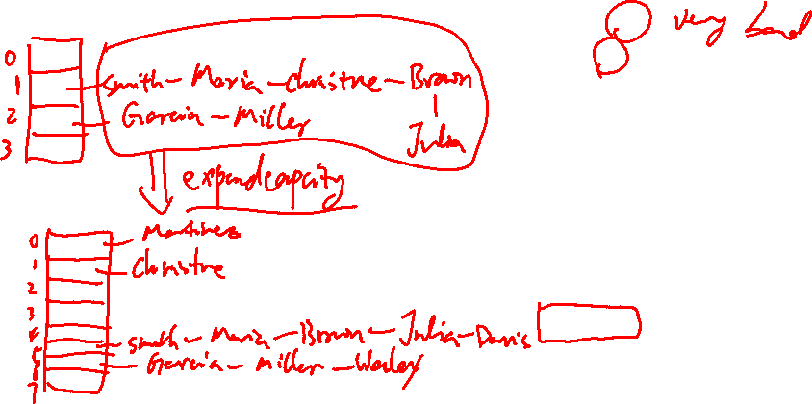
int getIndex(String k) {
return k.length;
}
# of buckets – 4
LoadFactor – 2
set(“Smith”, 1);
set(“Maria”, 2);
set(“Christine”, 3);
set(“Brown”, 4);
set(“Julia”, 5);
set(“Garcia”, 6);
set(“Miller”, 7);
set(“Davis”, 8);
set(“Wesley”, 9);
set(“Martinez”, 10);

Slide 8
Hash Table – draw the pictures (Linear Probing)
int getIndex(String k) {
return k.length();
}
# of buckets – 4
(i.e. the size of the array)
expandCapacity() called in set()
LoadFactor – .75
set(“Smith”, 1);
set(“Maria”, 2);
set(“Christine”, 3);
set(“Brown”, 4);
set(“Julia”, 5);
set(“Garcia”, 6);
set(“Miller”, 7);
set(“Davis”, 8);
set(“Wesley”, 9);
set(“Martinez”, 10);

Slide 9
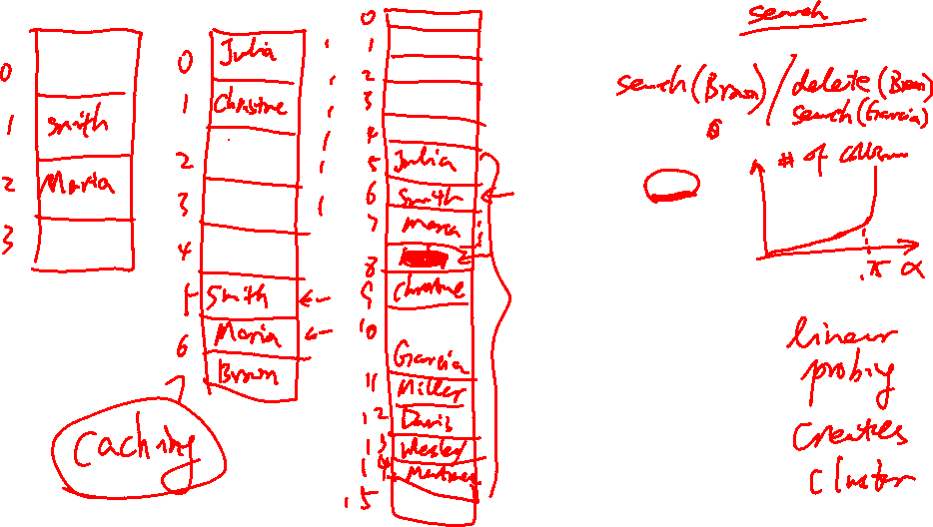
int getIndex(String k) {
return k.length();
}
# of buckets – 4
expandCapacity() called in set()
LoadFactor – .75
set(“Smith”, 1);
set(“Maria”, 2);
set(“Christine”, 3);
set(“Brown”, 4);
set(“Julia”, 5);
set(“Garcia”, 6);
set(“Miller”, 7);
set(“Davis”, 8);
set(“Wesley”, 9);
set(“Martinez”, 10);

Slide 10

Amortized analysis
Reasoning: worst case scenario analysis assumes that worst case input happens all the time but it may not be true.
Approach: Assume worst case but look at the whole picture

Slide 11
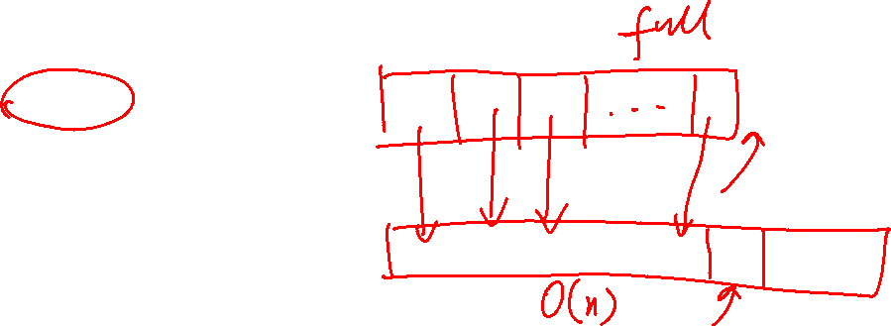
Example: insert into the end of arrays
What is the worst case runtime of this operation
A: O(1)
B: O(n)
C: O(logn)
D: I forgot what O is....

Slide 12
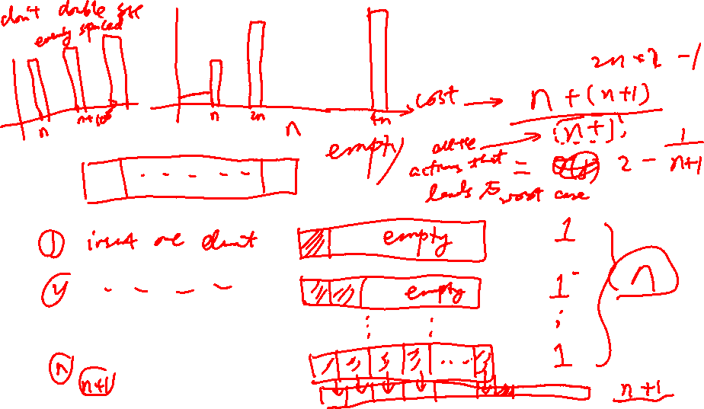
Example: insert into the end of arrays
Amortized analysis

Slide 13

Hashing - insert
If we insert an element in the hash table, what is the worst case runtime? We consider expanding capacity and rehashing after load factor is reached.
O(1)
O(n)
O(logn)

Slide 14

Hashing - insert
If we insert an element in the hash table, what is the worst case runtime? We consider expanding capacity and rehashing after load factor is reached.
O(1)
O(n)
O(logn)
Would separate chaining or linear probing
matter?
Yes
No

Slide 15
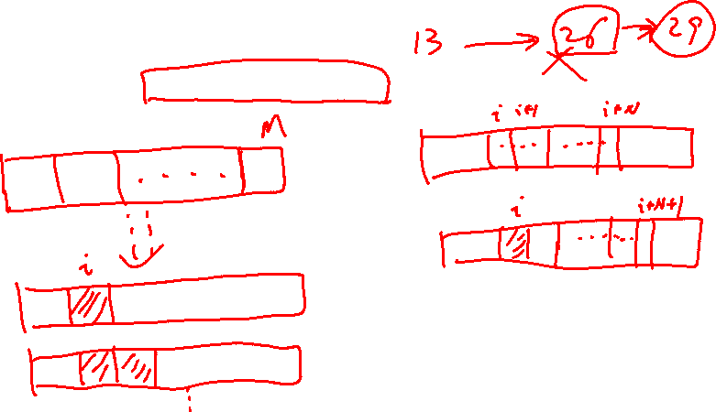
Amortized analysis of Hashing - insert
We assume that we double the size of table when we rehash. What is the amortized analysis result?

